Slide 1
Supervision: the cornerstone of doctoral education
Alexandra Bitušíková

Slide 2
Context (matters)
Back to Salzburg Principles I (2005):
  I. The core component of doctoral training is the advancement of knowledge through original research
  V. The role of supervision and assessment is crucial
Since 2005 – major changes in doctoral education:
  Trends towards structured programmes and doctoral schools (institutionalisation – rules, guidelines, organised skills training)
  Diversification of the population of doctoral candidates (international, ethnicity, gender, age, fulltime/part time/ distant)
  New purpose (instead of reproducing academics - human capital for knowledge based economies and societies
  Changing roles and responsibilities of supervisors as a result

Slide 3
Supervision today
Shift towards professionalisation of supervision (system and structure in all procedures, rules and guidelines; new professionals in doctoral education – highly skilled non-academic staff)
Professional development for supervisors (comprehensive supervisor training)
Changing pedagogy (from Master-apprentice relationship towards co-supervision or team supervision; doctoral candidate seen not as a student, but a young professional – early stage researcher)
Supervision culture

Slide 4
Why „training“ for supervisors?
New changes and challenges require new ways of supervision
To gain knowledge on new trends in doctoral education and in supervision
To share experience among senior and junior supervisors with the aim to improve supervision and quality of doctoral education at the institutional level
To develop as a professional and an individual (lifelong learning)
Career progression (Melita: to be a professor is not enough to be a supervisor – or?)

Slide 5
Why co/team supervision?
Good practice and a challenge
Common practice at many universities
Reasons for the shift towards co/team supervision: more inter/trans/multidisciplinary research, more pressure on candidates in terms of time, publishing, presenting – need for more guidance of various kinds)
However, co/team supervision requires good management – challenges:
  Unclear roles of supervisors (who is the main one; local and external...)
  Challenges of intellectual diversity across disciplines (e.g.supervisors disagree on the theoretical approach and fight with each other
Crucial to discuss co/team supervision from the start

Slide 6
Roles of supervisor by tasks and responsibilities
Expert/ active researcher
Manager
Mentor
Coach
Evaluator
Facilitator
Adviser
Sponsor
Critic
Teacher/ trainer
Examiner/reviewer
Boss
Friend
Brentel 2018
Psychologist (my addition)

Slide 7
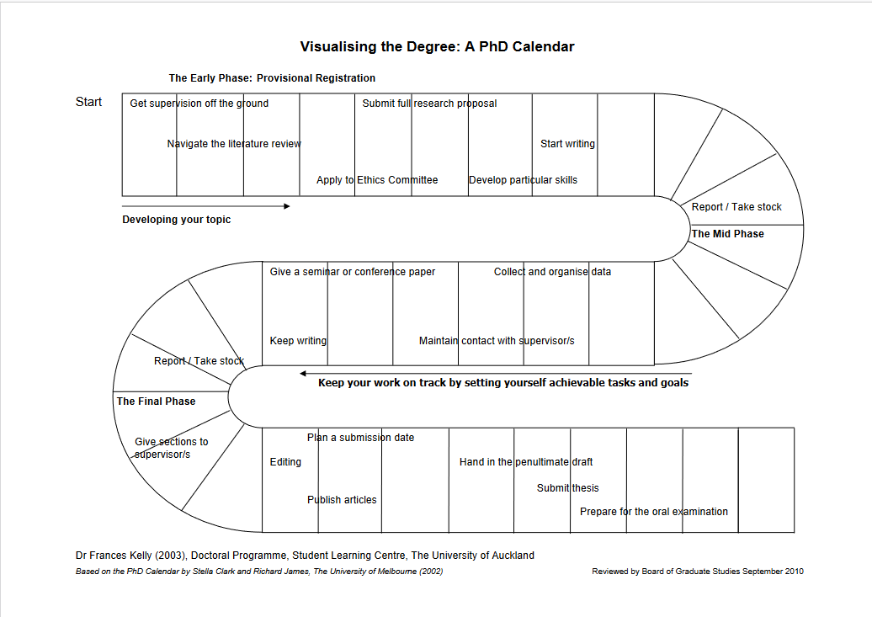

Slide 8
Importance of the initial phase
Building a good supervisor-candidate relationship
Introduction to institutional guidelines and procedures (welcome package, induction days, resources, access to library, ethics guidelines)
Clarification of mutual expectations
  https://graduatedivision.ucmerced.edu/sites/graduatedivision.ucmerced.edu/files/page/documents/expectation_scales.pdf
Agreement on meetings (frequency, written records, structure and objectives...)
Doc. project planning, objectives, timetable, milestones
Monitoring, feedback

Slide 9
Mid-phase
Data collection and analysis – key research phase
Writing – publications (thesis chapters) – important to keep writing (supervisor helps to identify good journals, reviews the candidate´s drafts)
Conference presentations (supervisor´s role is to open door to professional networks, to encourage candidate to actively participate in workshops/conferences at home and abroad)
Mobility abroad (?)
Monitoring, feedback

Slide 10
Final phase
Focus on dissertation – writing and finalising
Supervisor: reviewing dissertation draft step by step: critical feedback is crucial
In case of co-supervision or interdisciplinary research: both/all supervisors should discuss the draft dissertation in advance in order to avoid disagreement during the defence
Submitting the dissertation
Preparation for public defence

Slide 11
Who are the best supervisors?
According to surveys, doctoral candidates value a supervisor who is:
  accessible (has time and capacity to meet)
  approachable (supervisor creates a pleasant and friendly environment – the candidate does not have fear to express his/her problems or doubts)
  encourageing (supporting, motivating and inspiring)
  interested (supervisor is interested not only in results, but in knowing the doctoral candidate as a person)
  open and flexible (supervisor is open to discuss problems and to adapt to changing needs of the candidate)
  professional (supervisor is an expert and active researcher in the doctoral topic – s/he helps the candidate in networking)
  supportive (supervisor supports the candidate in his/her personal and career development, can recognise and help with crises)

Slide 12
Summary
Doctoral supervision today is a serious and challenging task that requires many more responsibilities than in the past
First, good supervision is based on active research of the supervisor and inclusive research environment
Second, good supervision includes taking care also of other than research challenges (incl. life-work balance and well-being)
„Training“ for new supervisors should become a norm and a must

Slide 13
Recommended sources
Brentel, H. 2018. Doctoral supervision. Handbook for establishing a productive and supportive supervision culture. Frankfurt am Main/ Nürnberg: KDD
Gatfield, T. and Alpert, F. 2002. The supervisory management styles model. In: Good, A., Herrinmgton, J. and Northcote, M. (eds.): Proceedings of the 2002 Annual International Conference of the Higher Education Research and Development Society of Australasia. Perth: Higher Education Research and Development Society of Australasia.
Lategan, L. O. K. (ed.). 2008. An introduction to postgraduate supervision. Stellenbosch: Sun Press.
Lee, A. 2012. Successful research supervision. London – New York: Routledge.
Taylor, S. and Beasley, N. 2005. A Handbook for supervisors. London -New York: Routledge.

Slide 14
Thank you very much

