Slide 1

MARDS
Report on the activities of the first year – University of Maribor (PP3)
Assoc. Prof. Dr. Matjaž DEBEVC
University of Maribor

Slide 2
List of UM activities
WP 1 - PREPARATION:
cooperation in the report:
  Report on the “state of the art” in doctoral education in Montenegro and Albania and comparison with EU practices

Slide 3

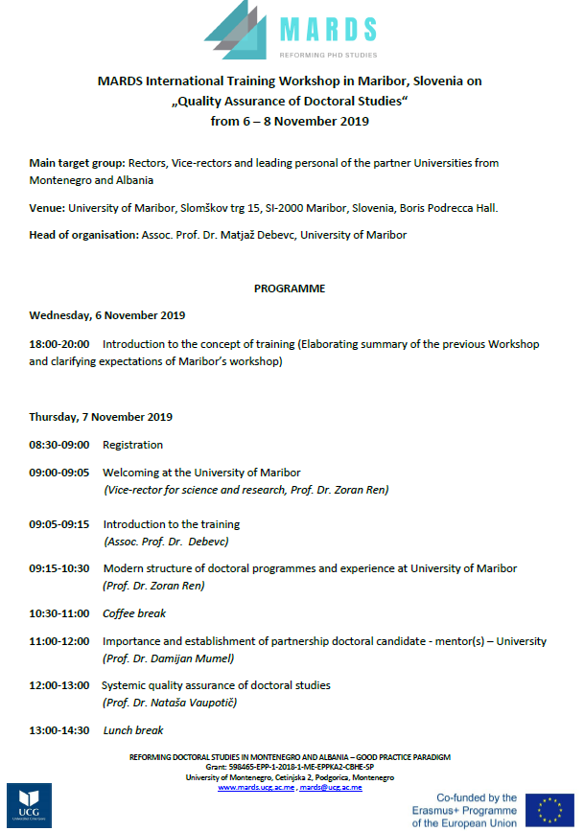
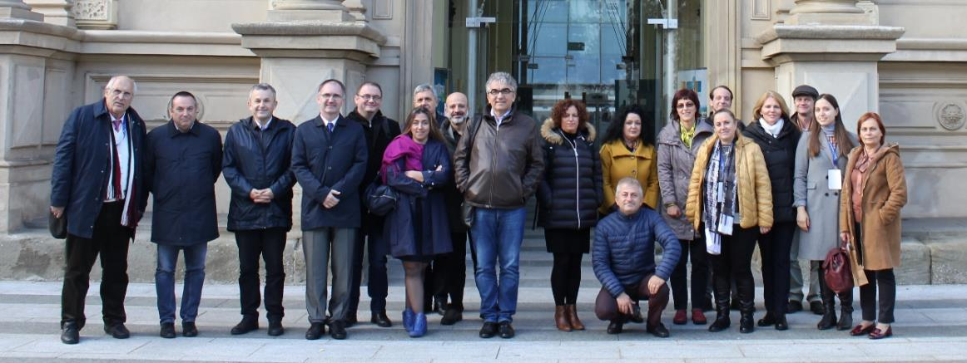
WP 2 – DEVELOPMENT:
Organization of the MARDS training on
Quality Assurance of Doctoral Studies in
Maribor, 6-8 November 2019
TO DO: Training in Maribor - proceedings

Slide 4
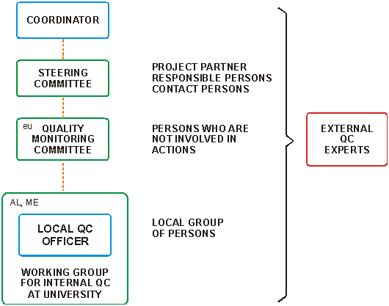
WP 5 - QUALITY MONITORING AND CONTROL

Slide 5
WP 5 - QUALITY
Quality plan
Quality monitoring questionnaires for:
  project meetings (Podgorica and Kotor)
  project trainings (Vienna, Dubrovnik, Banska Bistrica and Maribor)
  evaluation of project implementation
Analysis of results on questionnaires
Tender for subcontracting external QC experts
Providing 6 PhD courses with content from UM
Evaluation of deliverables
Evaluation of equipment
Evaluation of dissemination activities
Meeting and conclusions from QMC group

Slide 6
WP5 – QUALITY
Quality plan

Slide 7
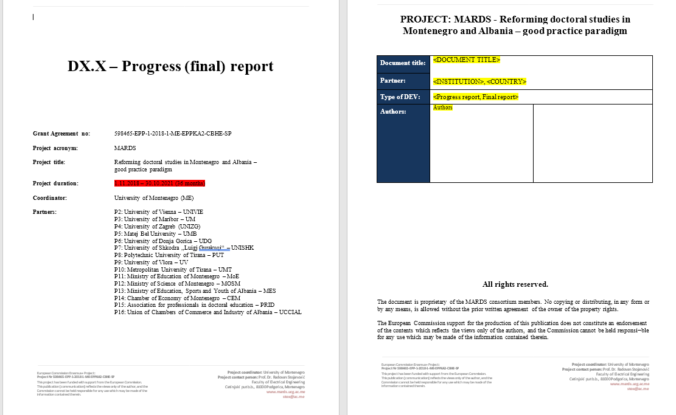
WP 5 - QUALITY
Word Template for formatting reports

Slide 8
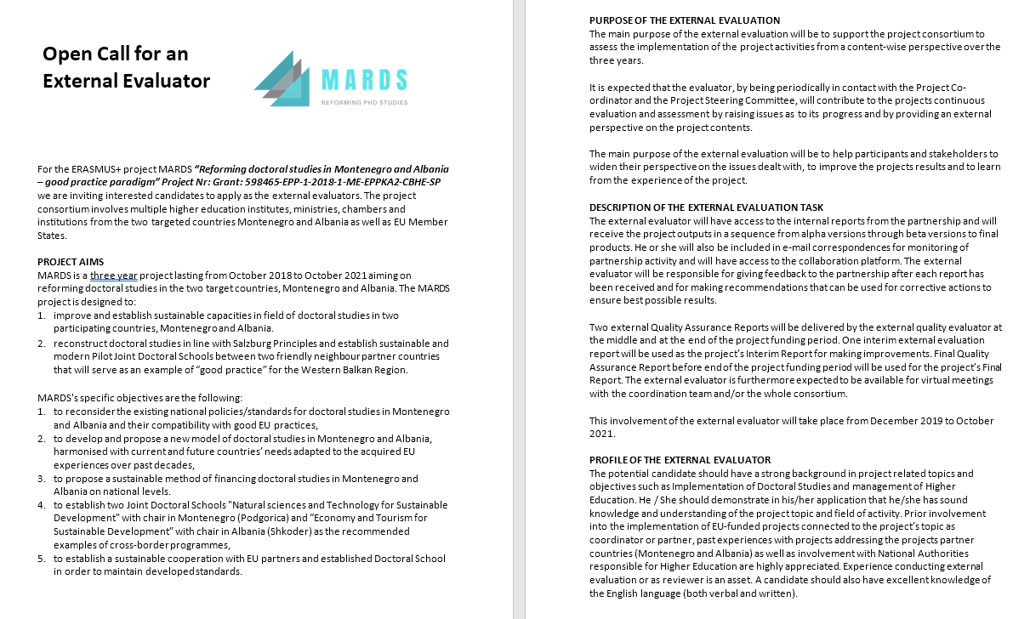
WP 5 - QUALITY
Call for External Evaluation - proposal

Slide 9
WP 5 - QUALITY
Results on meetings
The following meetings have been held within the 1st year from
15.11.2018 – 15.11.2019:
Kick off meeting of MARDS Erasmus+ Project held in Podgorica from 20.2. to 23.2. 2019 N=25
MARDS Erasmus+ Project Conference held in Kotor from 3.6. to 5.6. 2019 N=14
Bilateral meeting between Coordinator (University of Montenegro) and Partners from Albania of MARDS Erasmus+ Project held in Tirana from 22.9. to 23.9. 2019 N=15

Slide 10
WP 5 - QUALITY
Results on meetings (cont.)

Slide 11
WP 5 - QUALITY
Results on meetings (cont.)
Things that might be improved (high evaluations, however within these high grades these were graded lowest, still good):
85% | Communication amongst partners was effective | PG_Feb_19_Kick
77% | Presentations from policy makers, Ministries from Albania and Montenegro provided important content | Kotor_Jun_19

Slide 12
WP 5 - QUALITY
Results on meetings (cont.)
92% | How would you rate the session of Curricula preparation for joint programs? | Tirana_Sep_19
92% | How would you rate the session on the equipment purchasing? | Tirana_Sep_19
92% | Do you know what is required of you for the next phase of the project (up to the next project meeting)? | Tirana_Sep_19

Slide 13
WP 5 - QUALITY
Results on meetings (cont.)
Ideas for improvement :
Participation of the representative(s) of the Ministry of Education of Montenegro
Each partner should be informed clearly about the tasks and the deadline and what they have to present and not to be changed or informed at the very last minute.
To make a common and shareable Google document for every partner seperately, which is evident to all and in which we can see what is the next step together with deadlines.
Presence of all non-academic partners

Slide 14
WP 5 - QUALITY
Results on meetings (cont.)
Some rules for the reimbursement of travel and accommodation should explained before the meeting and also the list of the documents to be delivered to the coordinator for the occurred expenses.
Some activities were not clear enough but that was explained during the meeting
There seemed to be lack of commitment or enthusiasm shown from all participants from Montenegro and Albania - not much discussion, limited interest shown during the discussions. In addition, the most ambitious part of the project will be connected to accreditation of new joint doctoral programmes/ schools, which is totally depended on relevant ministries. It was also clear that the institutions that are going to establish new joint doctoral programmes/ schools do not have many clear ideas about the challenges and obstacles how to create such programmes/ schools. Lots of work needs to be done in order to clarify these steps and to fulfill the project objectives.

Slide 15
WP 5 - QUALITY
Results on meetings (cont.)
Ideas for improvement from Kotor_Jun_19:
Not participation from Ministry of Montenegro. The representative from Education Ministry of Albania is not in charge for doctoral education so her contribution is weak. Some unneeded disputes between some partners.
Rather low commitment from some partners (many did not participate at all), not a very good communication and organisation in advance; no involvement of the Ministry of Edu/ research in Montenegro - this creates a risk for the project success
Not enough info about Tender Procedures
some partners stay completely silent; some were not at all present

Slide 16
WP 5 - QUALITY
Results on meetings (cont.)
Ideas for improvement from Tirana_Sep_19:
Curricula is not prepared yet.
budget of the partners still not resolved, legal foundation of the programme
1. Lack of experts in Phd program application procedures. 2. Lack of time to deeply discuses the topic of the agenda.
Focusing only on engineering

Slide 17
WP 5 - QUALITY
Results on trainings / workshops
The following trainings / workshops have been held within the 1st year from 15.11.2018 – 15.11.2019:
MARDS Erasmus+ Training in Vienna on „Professional Management of Doctoral Studies“ from 25.6.2019 to 28.6. 2019 N=15
MARDS Erasmus+ Workshop in Dubrovnik on "Professionalization of Ph.D. supervision" from 5.9.2019 to 6.9. 2019 N=15
MARDS Erasmus+ „Training of academic and professional staff on EU practices of doctoral education: Collaborative Doctoral Programmes“ in Banska Bystrica from 2.10.2019 to 5.10. 2019 N=11
MARDS Erasmus+ „Quality Assurance of Doctoral Studies“ Training Workshop in Maribor from 6.11.2019 to 8.11. 2019 N=19

Slide 18
WP 5 - QUALITY
Results on trainings/W (cont.)

Slide 19
WP 5 - QUALITY
Results on trainings/W (cont.)
Things that might be improved (high evaluations, however within these high grades these were graded lowest, still good):
79% | Individually arranged meetings with cooperating partners at various faculties in different universities in Vienna were successful | Vienna_Jun_19
76% | The information (on tasks, materials for the workshop etc.) received before the meeting from the coordinator| Dubrovnik_Sep_19
85% | Communication amongst partners was effective | BanskaB_Oct_19
88% | Development of teamwork and positive attitudes was evident | Maribor_Nov_19

Slide 20
WP 5 - QUALITY
Results on trainings/W (cont.)
Ideas for improvement from Vienna_Jun_19 :
the training should be attended by students who are in the PhD process from all participating universities to talk about the difficulties they face, compiling a concrete doctorate curriculum
to achieve a positive result, the participating team should not change from training to training
Training should focus on curricula preparation of doctoral study program.
More administrative staff to be involved into trainings and meeting people from the same work environment from other universities

Slide 21
WP 5 - QUALITY
Results on trainings/W (cont.)
Ideas for improvement from Dubrovnik_Sep_19:
During the presentations a set of possible issues were introduced and discussed but most of the time we missed possible solution adopted by well established institutions. I am aware that there are no formulas in such cases but common practices and success stories could be shared.

Slide 22
WP 5 - QUALITY
Results on trainings/W (cont.)
Ideas for improvement from BanskaB_Oct_19:
1) Bad communication between some partners and 2) lack of willingness from some partners to be more active during discussion part
Cooperation between Albanian and Montenegro partners, lack of legal information
Lack of teamwork and mutual comprension.

Slide 23
WP 5 - QUALITY
Results on trainings/W (cont.)
Ideas for improvement from Maribor_Nov_19:
1. more practical work missing 2.one day more as practical work in groups missing
First day lasted too long up to 17.00 - No evening event as MARDS team

Slide 24
WP 5 - QUALITY
Results on Cooperation and Collaboration
Preliminary results, the data should be gathered from most of participants. Indicated communication and partners‘ contribution to the project

Slide 25
WP 5 - QUALITY
Elaboration on Cooperation and Collaboration
Continuous and efficient communication among partners takes place with support of appropriate tools.
Communication between partners need to be better. Especially between Albanian partners.
Maybe we can organize meeting to work together on concrete task. For example, UDG and UDG must sit together, all team, to prepare for accreditation PHd and national dissemination.

Slide 26
WP 5 - QUALITY
Elaboration on Cooperation and Collaboration
We (me and, if applicable, my colleagues in my organization) can actively contribute to all relevant project processes.
Sometimes colleagues at my organization don't have idea of the project. They are figurative sometimes.

Slide 27
WP 5 - QUALITY
Elaboration on Cooperation and Collaboration
General ideas and proposals on how to improve partners' cooperation and collaboration
Having regularly TC meetings
Coordination and partner cooperation is really good. Sometimes maybe we need some bilateral meeting between partners who is in charge with some tasks.
Based on transparency and communication.

Slide 28
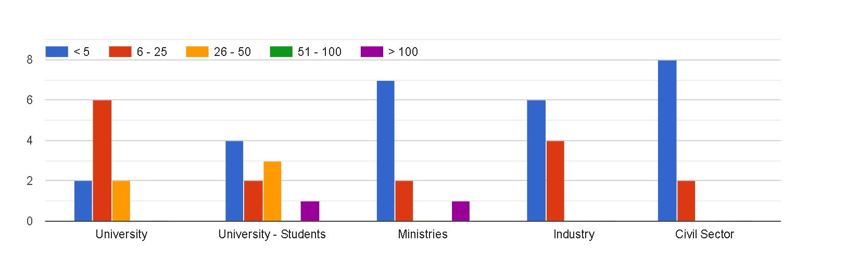
WP 5 - QUALITY
Results on Impact and Sustainability
Preliminary results, the data should be gathered from most of participants. Results of people engagement by sectors (ministries, industry, Civil Sector – low engagement):

Slide 29
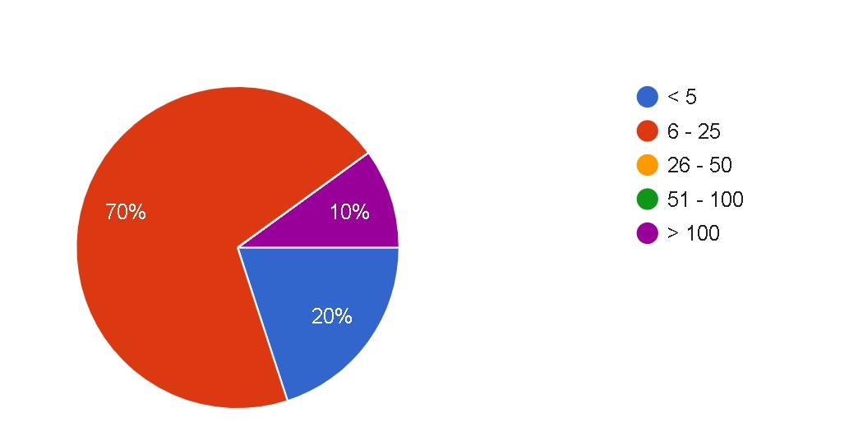
WP 5 - QUALITY
Results on Impact and Sustainability
Preliminary results, engagement of EU stakeholders:

Slide 30
WP 5 - QUALITY
Elaboration on Impact and Sustainability How many individuals from the following target groups did you involve into the project activities implemented in the evaluated project period?
We have invited acadamic staff, students and tourism businesses in our MARDS Meetings and promotion activities.
In next phase second year of the project, based o project plan, it will be involved more persons from business, NGO, Phd candidate.
It is our first experience in this field.

Slide 31
WP 5 - QUALITY
Elaboration on Impact and Sustainability
How many national and / or European stakeholders did you inform about the project, its aims and activities and, if applicable, results?
via PRIDE Newsletter
According to the project plan, next year wil ne more intensifive, because of the more communication with stakeholder.
It is our first experience in this field.

Slide 32
WP 5 - QUALITY
Elaboration on Impact and Sustainability Were project results available so far have been of use as an added value to your own organization?
Not yet. More time is needed.
There's is sometimes missing of action to speed up some processes.
Yes, especially in areas of training, transfer knowledge - EU practice. Especialy was useful Internal Quality plan by EU partners – University of Maribor and University of Vienna.
To be able to organised for the first time PhD study in University.

Slide 33
WP 5 - QUALITY
Elaboration on Impact and Sustainability Have you been able to inform your colleagues in your organization about the project and its results so far?
Only few of my colleagues are interested.
We have organized several meetings with colleagues and one meeting with senate members.
More than ten member of the UDG team, on the level of coordinator, dean, general manager participate in activities in this project.
staff based and group based

Slide 34
WP 5 - QUALITY
Results on Impact and Sustainability ->
Have you been able to connect project results and information to your organizations' regular activities?
Yes we have created synergies from other projects that are on going at our Faculty.
For example WP5 - According to the prepared Internal Quality plan by EU partners – University of Maribor and University of Vienna as well according to the presented experience at meeting in Dubrovnik, UDG has done revision of standards on PhD studies within PhD program which has been in process of accreditation “Information Technologies”. Having in mind that this PhD program has been in process of accreditation by Agency for Control and Quality Assurance of Higher Education (ACQAHE) in Montenegro, UDG team had chance to implement some suggestions and recommendations presented by EU partners, such as Standards, EU practice of preparation surveys for evaluations etc. Program has been successfully evaluated.
Working in groups and informing the staff members.

Slide 35
WP 5 - QUALITY
Results on Impact and Sustainability
Do you identify actions/strategies to further use, develop and disseminate project's results beyond the project framework
Two reports prepared by Zagreb University and Vienna University can be used for further improvement in our University.
Yes, especially in further activities and cooperation with Ministries of science and their program of stipend of Phd study, business comunity and etc.
Based on ART programs, news papers, activities in university with staff and students.

Slide 36
WP 5 - QUALITY
Results on Impact and Sustainability
General ideas and proposals on how to improve partners' impact and sustainability
Much more pressure should be done to Ministries to perform their tasks in the frame of this project.
we can organize some concrete team working on concrete MARDS output, during the working meeting . Example, team sit together one day, share idea, make consultation, about proposal for improvement of PhD studies in Montenegro.
Based on transparency and communication using collaborative tools (Google Doc)

Slide 37
WP 6 - DISSEMINATION
UM web page – March 2019 (facts about the project)
UM News- April 2019 (presentation of the project)
Carreer fair – April 2019 (presentation of the project)
UM News – November 2019 (press release about the MARDS training on Doctoral Studies)
TO DO:
Article about MARDS project in Umniverzum – University Newspaper (January – February 2020)
Training proceedings from Training at UM, Maribor

Slide 38


Facts about the MARDS project on the UM web page

Slide 39
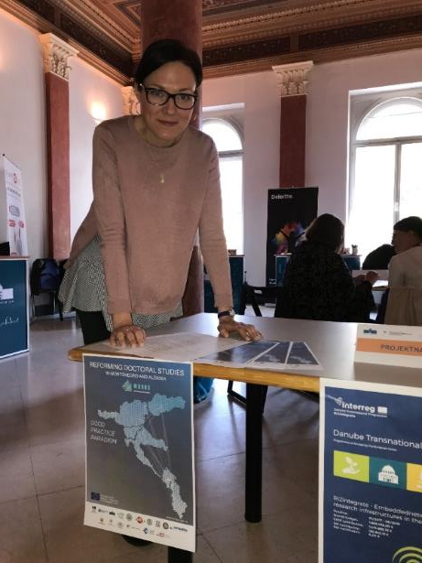
Presentation of the MARDS project at the Career fair at the University of Maribor, April 17, 2019.

Slide 40
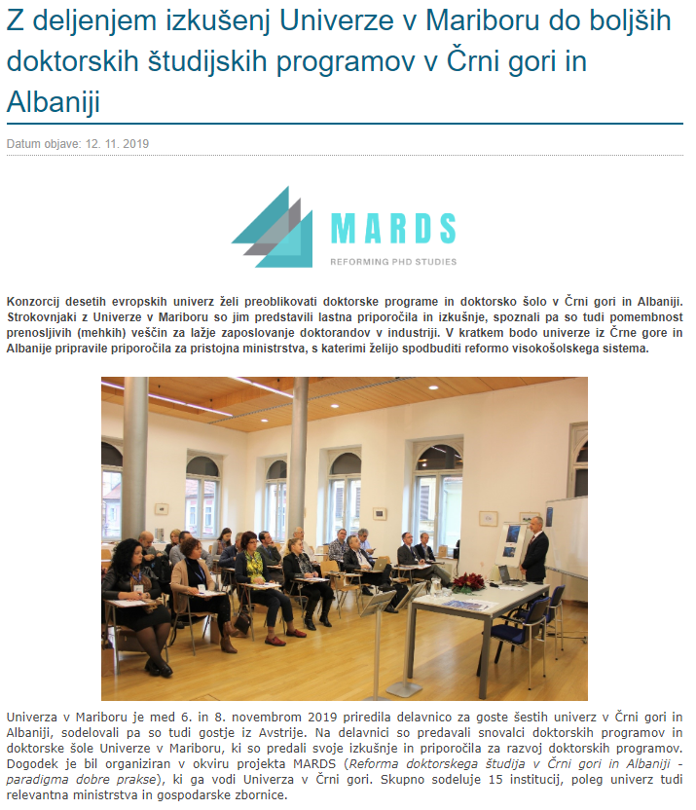
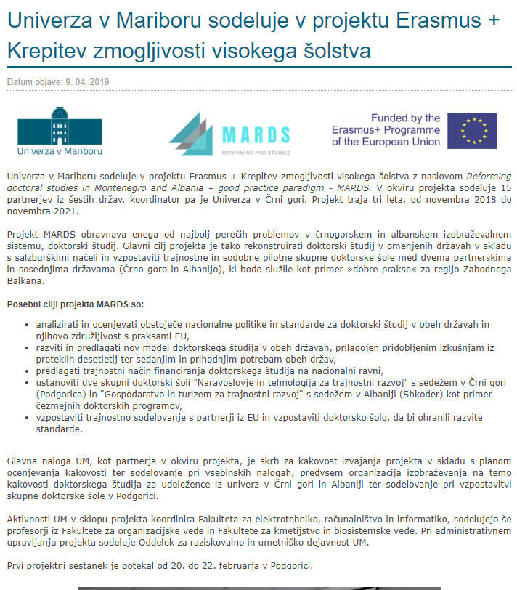
Articles in the UM Newsletters

Slide 41
WP 8 - MANAGEMENT
Participation of the UM project team in Kick-off meeting in Podgorica and in Vienna
Preparation of the reporting documents and uploading them on the project common place
Coordinating the UM project activities
Monitoring the financial issues
Communication with Coordinator and with UM team members
Preparation of the bilateral contract for performing PhD courses – University of Maribor and University of Montenegro

