Slide 1

REPORT OF THE ACTIVITIES PERFORMED DURING THE FIRST YEAR OF THE PROJECT
Phd. Eng. Alma Afezolli
Polytechnic University of Tirana

Slide 2

REPORT OF THE ACTIVITIES PERFORMED DURING THE FIRST YEAR OF THE PROJECT
Activities of the first year:
Participation with 2 representatives in Kick off meeting, University of Montenegro
Fulfilment of “Questionnaire for founds” and sending the required information to the coordinator of the project
Fulfilment of “Questionnaire for existing doctoral policy” and sending the required information to the coordinator of the project
Participation with 2 representatives in the Conference “MARDS CONFERENCE KOTOR”, Kotor
Participation with 3 representatives from administrative and scientific staff in MARSD Training in Vienna on “Professional Management of Doctoral Studies”, Vienna.
Notes:
During the first year of the MARSD 2018-2019 project activities, the Polytechnic University of Tirana has attended and accomplished the following tasks:
On February 20-23 2019 was organized the kick off meeting by the coordinator of the project at the University of Montenegro. During the meeting we were presented with management structures and documents. After we were given two questionnaires to fulfil in order to report the state of art of doctoral studies in Albania.
Participation with 2 representatives in the Conference “MARDS CONFERENCE KOTOR”, Kotor. In this Conference has been discussed further about the questionnaires completed by all partners, in order to prepare a whole document, to be aware regarding the existing legal situation of Phd schools in Albania.
Participation with 3 representatives from administrative and scientific staff in MARSD Training in Vienna on “Professional Management of Doctoral Studies”, Vienna. It was a very useful training for the partners, based upon the experience of the Phd Centre of Vienna University.

Slide 3

REPORT OF THE ACTIVITIES PERFORMED DURING THE FIRST YEAR OF THE PROJECT
Activities of the first year:
Participation with 3 representatives from academic staff who are supervising doctoral candidates ne “Workshop on professionalization of Ph.D. supervision”, Dubrovnik.
Participation with 3 representatives on “MARDS Bilateral meeting between the Coordinator and partners from Albania, Tirana.
Participation with 3 representatives on “Training of academic and professional staff on EU practices of doctoral education: Collaborative Doctoral Programmes”, Banska Bystrica.
Participation with 2 representatives on training workshop on “Quality Assurance of Doctoral Studies”, Maribor.
Preparation of the report on equipment
Notes:
Participation with 3 representatives on “MARSD Bilateral meeting between the Coordinator and partners from Albania, Tirana. It was organized by UMT and resulted successful.
Participation with 3 representatives on “Training of academic and professional staff on EU practices of doctoral education: Collaborative Doctoral Programmes”, Banska Bystrica. It was a very interactive meeting, many discussions, a lot of comments, a well done job by the hosted University and all the partners.

Slide 4
REPORT ON THE EQUIPMENT
Approving the list of the equipment basing on the purpose of the project and the institutional needs;
The finalization of the specifications on the equipment and receiving the confirmation from Brussel;
Realization of the official procurement procedure, according to the public procurement Albanian law, on the online platform of public procurement. This process was concluded successfully and we have in our inventory the purchase equipment.
Documentation management by the procurement and project office at PUT Rectorate
:

Slide 5
Here is the List of equipment purchased
No. | Description of the PUT equipment
1 | Videoconference system (portable).
2 | Xerox, Printer, Scanner
3 | Network devices + server + 2 laptop
4 | Transparent Interactive Screen-Board
Notes:
Regarding the dissemination activities we have published on our website a short project description including also the outcomes http://upt.al/projekte;
We have also shared the Project page in our official Facebook page;
Meanwhile we have planned to organize an open information day for the project with the academic staff and all the specialist who may attend or contribute in the Phd schools that are planned to be pilot of this project

Slide 6

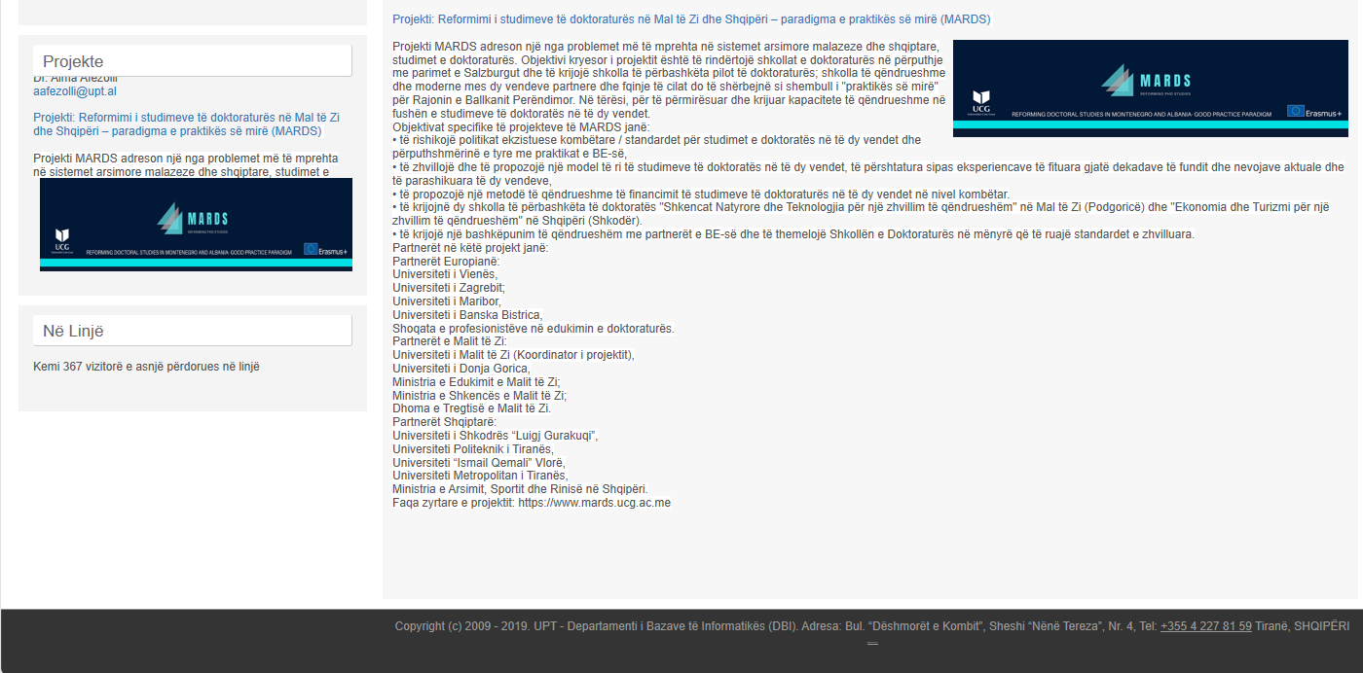
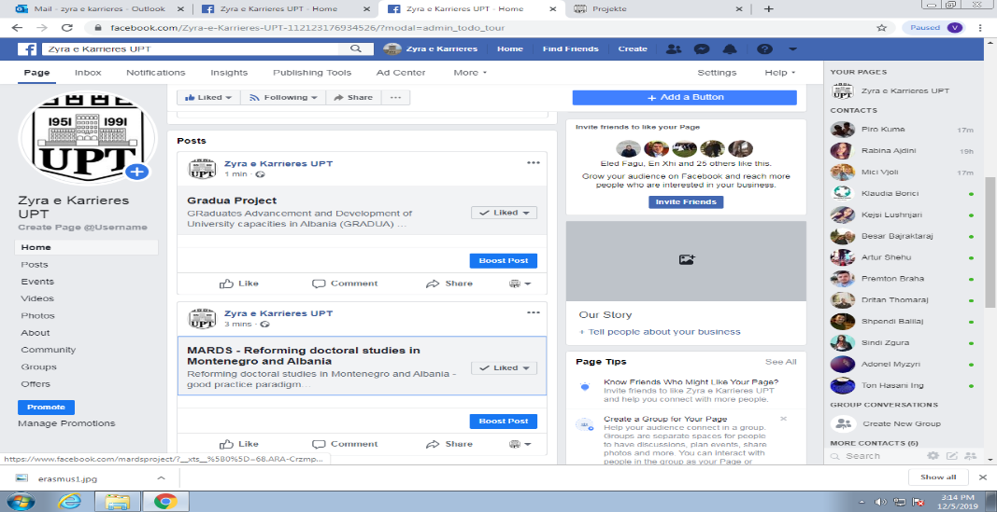
REPORT OF THE ACTIVITIES PERFORMED DURING THE FIRST YEAR OF THE PROJECT
Dissemination Activities and future actions:
Publication on our website of a short project description http://upt.al/projekte;
Shared the Project page in our official Facebook page;
Planned to organize an open day serving the dissemination of the project
Notes:
Regarding the dissemination activities we have published on our website a short project description including also the outcomes http://upt.al/projekte;
We have also shared the Project page in our official Facebook page;
Meanwhile we have planned to organize an open information day for the project with the academic staff and all the specialist who may attend or contribute in the Phd schools that are planned to be pilot of this project

Slide 7

THANK YOU!

