Slide 1


Draft Structure of PhD Program in “Economics and Sustainable Tourism”
Prof. dr.Arjeta Troshani
University of Shkodra “Luigj Gurakuqi”

Slide 2
MISSION of PhD Program
The Doctoral Program in Sustainable Tourism Economics offered at the Faculty of Economics of the University of Shkodra will form highly qualified researchers in the field of management and innovative development of tourism businesses.
The program will provide candidates with the opportunity to deepen and develop theoretical and methodological knowledge and to produce a contribution to an original research.

Slide 3
PURPOSE
The purpose of this PhD program will be to train qualified specialists to contribute to the development of sustainable tourism in Albania and in particular in the Northern Region where tourism as a priority sector of economic development will be further explored and developed.
By pursuing quality and strong standards of excellence, doctoral students will have the opportunity to be in direct contact with employers in the strategic sectors of the country's economy and the region to gain the potential for their ideas.
Industry and business representatives will also have the opportunity to ask potential students to adapt and further research to the future developments of their respective organizations and implement research innovative ideas.

Slide 4
OBJECTIVES of PhD Program
a) Contribute to in-depth research on small and medium-sized businesses to serve the development of innovation and the improvement of the quality of tourism services.
b) Strengthen the links between business and university by guiding scientific research on economic developments and strategic priorities of the country such as the tourism sector.
c) Provide guidance focused on developing and exploring new ideas with a focus on creating links and networks between business and academia.
d) To serve as a model where scientific research is carried out in the light of current developments in the country and being useful in explored environments to justify the sources of funding that support it.

Slide 5
Draft Structure of PhD program
Duration: 3 years (180 credits)
1st year 60 credits: Fields of scientific research, Project proposal presentation
2nd year 60 credits : 1-3 months internship abroad, project proposal improvement and start thesis preparation on the Scientific Research
3rd year 60 credits: Scientific research +Thesis preparation and defence

Slide 6
Draft Structure of PhD Program
Details per Semester
First Semester: Obligatory courses + Research path+ Project proposal presentation (30 ECTS)
●Third Semester: 1-3 month Internship + Report on Internship and further development of project proposal on scientific research (30 ECTS)
●Fourth Semester: Work on Thesis Preparation and development of scientific research (30 ECTS)
Fifth Semester: Scientific research + Preparation and presentation of Draft PhD Thesis at Department and Faculty Level (30 ECTS)
Sixth Semester: Oral examination consisting in a public defence of the doctorial thesis (30 ECTS)
Second Semester: Elective courses + Final Version of Project proposal (30 ECTS)
First year
60 ECTS
Second Year
60 ECTS
Third Year
60 ECTS

Slide 7
Draft Curricula of PhD
“Economics and Sustainable Tourism”
Basic Courses (fields of scientific research): 30 ECTS
Advanced Strategic planning of touristic destinations (UNISHK, UP, UCG) 7 ECTS ( 75 hours) ( A.Troshani, B.Bushati, A.Hafizi, E.Bushati)
Economics of sustainable development (UNISHK, UV, UCG) 7 ECTS ( 75 hours) ( B.Dragusha, A.Begani, F.Molla)
Advanced Research Methods (UNISHK, UV, UMT, UP) 7 ECTS ( 75 hours) ( A.Borici, E. Kalaj)
Management of sustainable tourism (UNISHK, UV, UP, UCG) 9 ECTS (75 hours) ( M.Dibra, E.Hoxhaj)

Slide 8
Draft Curricula of PhD
“Economics of Sustainable Tourism”
Elective courses (UNISHK, UPT, UMT, UCG, UV,UM) 30 ECTS
1. Advanced Management of biodiversity, (UNISHK, UV, UCG) 9 ECTS (A.Bekteshi,M.Rakaj, N.Dibra, A.Neziri)
2. Management of Project Management, (UNISHK,UCG) 7 ECTS (E.Osmani, E.Bashi, G.Dibra)
3. Information System in Tourism (UNISHK, UMT) 7 ECTS (B.Bushati)
4. Social entrepreneurship and Innovation (UNISHK, UP, UMT) 7 ECTS ( A.Begani, Dh.Hoxha, M.Guli)

Slide 9
Courses proposed by UOM
Data Visualization and Visual Analytics in Tourism and Recreational Planning – Prof.Radovan Stojanovic
Tourism and Environment – Prof.Djurdica Pejovic
Environmental Economics in Tourism – Prof.Sanja Pekovic

Slide 10
Courses proposed by UNIV
Research Methodology – Prof.as.dr.Kristofor Lapa, Enkelejd Mehilli PhD
Maritime Tourism – Prof. as.dr.Kristofor Lapa, Prof.as.dr.Elenica Pjero
Yellow Tourism – Prof.as.dr.Elenica Pjero, Enkeljed Mehilli, PhD
Big Data and Artificial Intelligence – Prof.as.dr.Llambrini Sota, Prof.as.dr.Eljona Proko

Slide 11
Courses proposed by University of Maribor
Tourism Discourse – Prof.Jasna Potocnik
Rhetoric, Public Relations and Digital Media – Prof. Jasna Potocnik

Slide 12
Courses proposed by UPT
Recovery and revitalization of monuments – Prof.dr.Florian Nepravishta
Cultural Property Management – prof.as.dr.Elfrida Aliu
Restoration of urban centers and historical landscapes – Prof.as.dr.Armand Vokshi

Slide 13
OTHER COURSES Proposed by other MARDS PARTNERS (UMT, UV,UZ)
??????

Slide 14
Labour Market Survey
Employment trend in tourism industries in Albania
(numbers are in thousands)
Tourism Industries/Years | 2014 | 2015 | 2016
Accommodation (Hotels, other) | 19.4 | 21.8 | 30.1
Passenger transportation | 6.2 | 6.2 | 7.8
Travel Agencies and booking services | 1.1 | 1 | 1.6

Slide 15
Albanian Legal Framework
Udhezimi nr.31 date 29.12.2017
Akti i Themelit
Akti i Akreditimit
Marreveshja bashkepunimi ( ofrimi i programeve te perbashketa)
Marreveshje specifike per programin e perbashket per autoresine e syllabuseve,.. etj

Slide 16
Albanian Legal Framework
Ligji Nr.80 viti 2015
Doktoratura do bazohet ne projekt kerkimor qe prezantohen individualisht nga kandidati
Vendimi i K.M. nr.112 date 23.02.2018 per kriteret per fitimin e grades “Doktor”
Vendimi nr.41 date 24.01.2018 per elementet e programeve te studimit te ofruara nga IAL
Vendimi i KM nr.808 date 11.12.2019

Slide 17
Proposed staff to be involved from UNISHK
Prof.dr.Adem Bekteshi
Prof.dr.Gezim Dibra
Prof.dr.Arjeta Troshani
Prof.dr.Elez Osmani
Prof.dr.Fatbardha Molla
Prof.dr.Anila Neziri
Prof.as.dr.Alma Hafizi
Prof.as.dr.Blerta Dragusha
Prof.as.dr. Albana Begani
Prof.as.dr.Brilanda Bushati
Prof.as.dr.Mirjam Dibra
Prof.as.dr.Ardita Borici
Prof.as.dr.Elidiana Pema
Prof.as.dr.Ermira Kalaj
Prof.as.dr.Nevila Dibra
Prof.as.dr.Meri Guli
Prof.as.dr.Edlira Bushati
Prof.as.dr.Dhurata Hoxha
Prof.as.dr.Marash Rakaj
Prof.as.dr.Entela Hoxhaj

Slide 18
Proposed staff to be involved from UOM
Prof.dr.Radovan Stojanovic
Prof.dr.Djurdica Pejovic
Prof.as.dr.Sanja Pekovic

Slide 19
Proposed Staff to be involved from UNIV
Prof.as.dr.Kristofor Lapa
Prof.as.dr.Elenica Pjero
Prof.as.dr.Eljona Proko
Prof.as.dr.Llambrini Sota
Enkeljed Mehilli, PhD

Slide 20
Proposed Staff from Maribor University
Prof.as.dr.Jasna Potocnik

Slide 21
Proposed staff from Polytechnic University of Tirana
Prof.dr.Florian Nepravishta
Prof.as.dr.Elfrida Aliu
Prof.as.dr.Armand Vokshi

Slide 22
Other staff to be involved from EU MARDS PARTNERS
?????

Slide 23
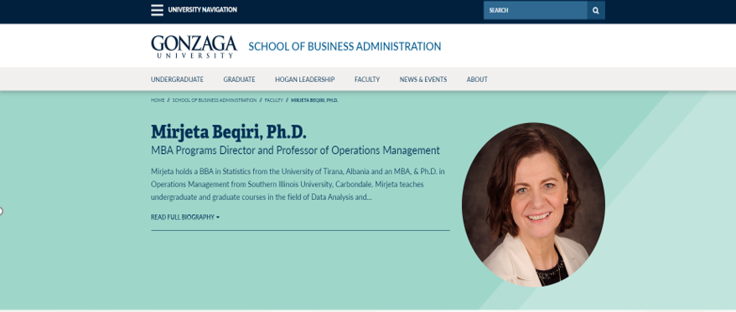
Key Note Speakers

Slide 24
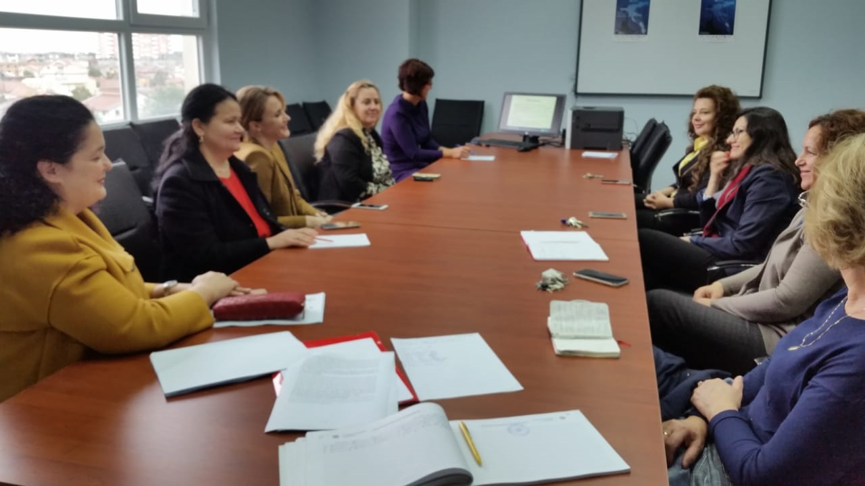

Slide 25

DISCUSSIONS and QUESTIONS

