Slide 1


MARDS Final Conference
UNISHK
Prof. dr.Arjeta Troshani
University of Shkodra “Luigj Gurakuqi”
03.11.2022

Slide 2
Opening ORDER FROM EDUCATION MINISTRY
Order number 174 date 04.04.2022 nr.1848/3 prot to open the PhD School at Economic Faculty of Shkodra University “Luigj Gurakuqi” – 8 recommendations
Dissemination activities: Europe Day Fair 03.05.2022

Slide 3
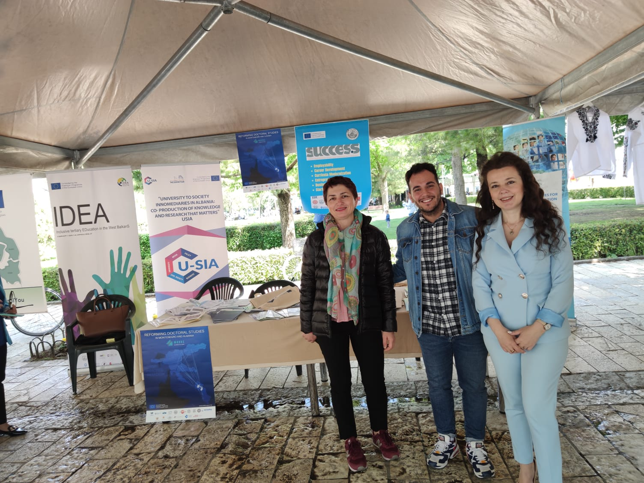

Slide 4
Meeting with Working Group
12.04.2022 – meeting with working group with participation of Rector of UNISHK and two vice Rectors finalized with suggestions and recommendations from all participants.

Slide 5
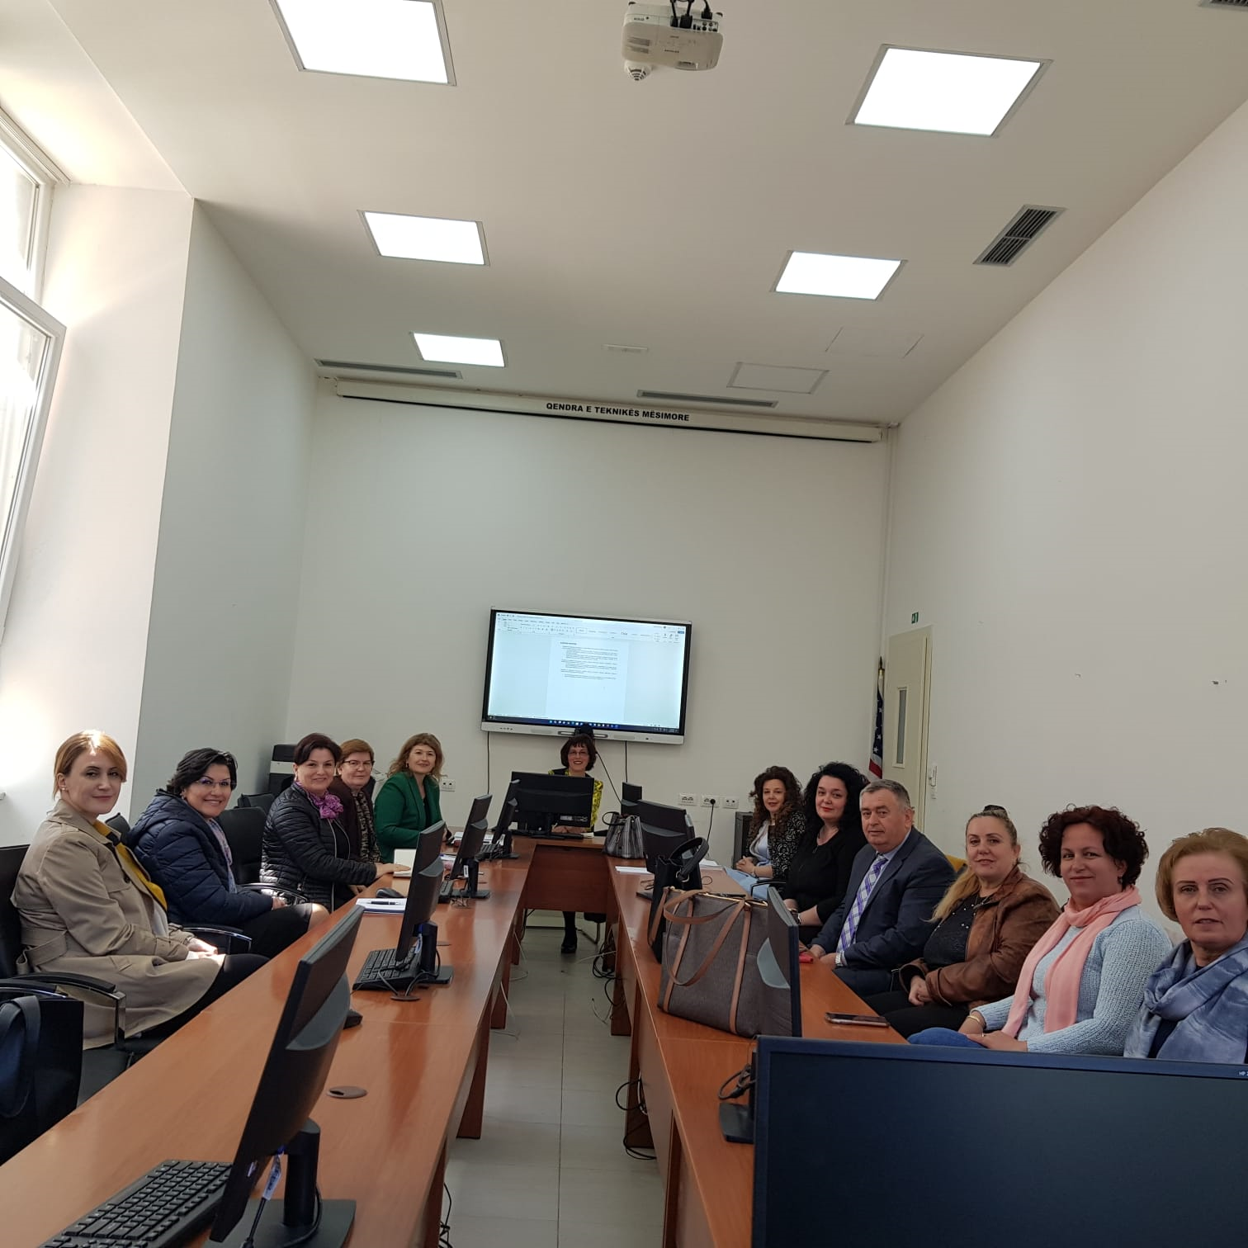

Slide 6
Meeting - online
1. Organizational positioning of MARDS Doctoral Studies for Albania . Whether doctoral studies in Albania should be hosted by Rectorate University of Shkoder or by Faculty of Economics of University of Shkoder? – 13.05.2022

Slide 7
Answer from Ministry received on 15.06.2022
In relation to this letter, MAS states that the study program is in the area of responsibility of the Faculty of Economics and Tourism Department

Slide 8
Fulfilment of MAS recommendations
All documents send from Faculty of Economy to Rectorate – 04.07.2022
Decision of Senate and of Board of Administration for the reducing of quota finalized 29.07.2022

Slide 9
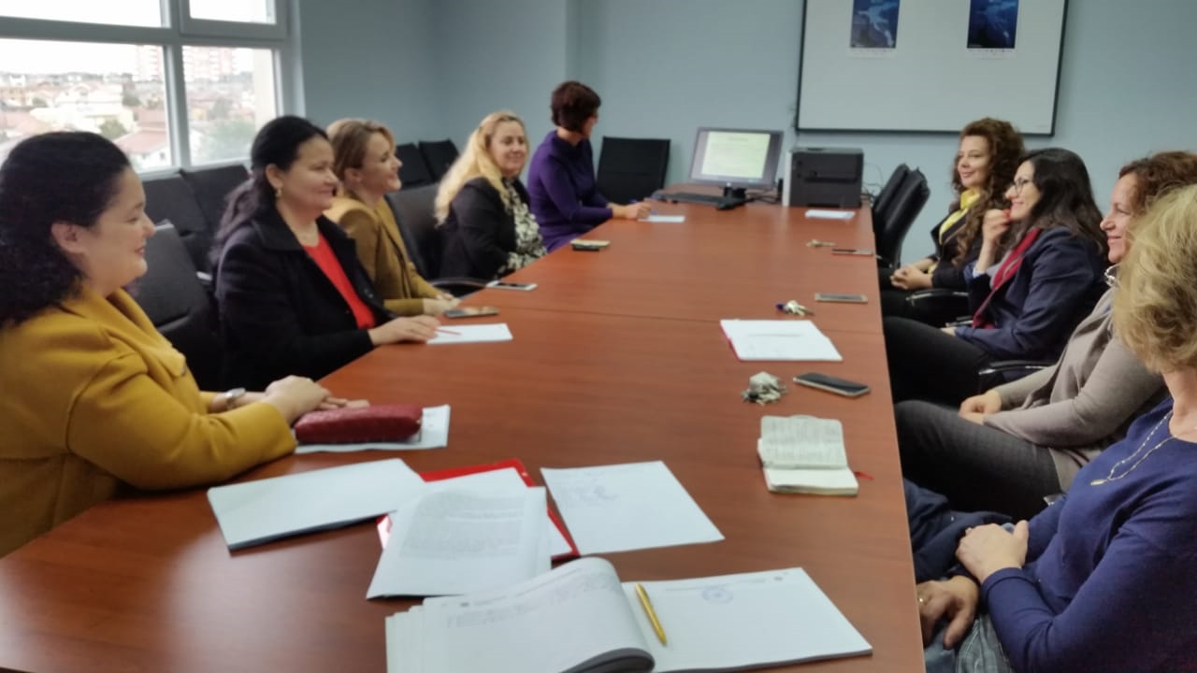

Slide 10
Future Activities
Communication with MASR
Start of the PhD program – enrolment of first generation
Dissemination with national and local media

Slide 11

DISCUSSIONS and QUESTIONS

