Slide 1
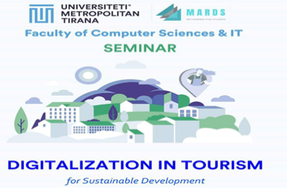
REFORMING DOCTORAL STUDIES IN MONTENEGRO AND ALBANIA
GOOD PRACTICE PARADIGM
DIGITALIZATION IN TOURISM
“HOW TO DEVELOP SMART TOURISM BY MEANS OF ACADEMIC STUDIES?”,
DIGITALIZATION IN TOURISM
“HOW TO DEVELOP SMART TOURISM BY MEANS OF ACADEMIC STUDIES?”,
Metropolitan _ Tirana_Albania
Betim Cico
bcico@gmail.com
Date: 20.02.2020
Place: Tirana, Albania

Slide 2

Overview
Introduction
Empty slide, to be fulfill at the end of the presentation through disscussions…….

Slide 3
STEM in centuries
18 – 19 century of mathematics
19 – 20 century of physics
20 century of Electronics
21 century of IT
        DIGITALIZATION
        SMART4ALL
Universities and Academic Study
Smart Universities
offer Smart Academic Study

Slide 4

TRENDS: Horizon 2020 Project SMART4ALL
Digitized Environment
Digitized Agriculture
Digitized Transport
Digitized Anything

Slide 5
MARDS and PhD study
Object of MARDS ERASMUS+ Project
PhD Study and METROPOLITAN UNIVERSITY
SMART TOURISM – IT school of the PhD study
Interdisciplinary PhD school
Faculty of CS and Faculty of Economics
National and International Best Professors of the fields
Best Students with master study in the fields of:
IT, BI and E-T
To support Albania Tourism and Albanian economy, and to be part of international system.

Slide 6

The way to prepare the good PhD study

Slide 7
How to Design Smart Tourism
How to Design Smart Tourism Destination: From Viewpoint of Data
Hidekazu Kasahara, Masaaki Iiyama, Michihiko Minoh
Kyoto University
EU-Japan Workshop on Big Data for Sustainability and Tourism 2
(Slides from 7 – 16 https://www.slideshare.net/HidekazuKasahara/how-to-design-smart-tourism-destination-from-viewpoint-of-data)

Slide 8
How to Design Smart Tourism Background

Slide 9
How to Design Smart Tourism

Slide 10
How to Design Smart Tourism

Slide 11
How to Design Smart Tourism

Slide 12
How to Design Smart Tourism

Slide 13
How to Design Smart Tourism

Slide 14
How to Design Smart Tourism

Slide 15
How to Design Smart Tourism

Slide 16




How to Design Smart Tourism
Some Research Objectives for our PhD study in Smart Tourism

Slide 17
How to Design Smart Tourism
Activities in Tirana – Vlora – Durresi – Shengjini- Saranda - Valbona - Kukesi - Berzovica– Plava Gucia- Pogradeci – Struga
Collaboration with Municipalities and Prefectures.
We will start a workgroup for implementation sample cases and pilot project.
Ventures/Local governments/University
Symposium for Publication – MECO Conference as well
SMART4ALL Horizon 2020 Project activities and solutions as a good practice for our PhD students.

Slide 18

How to Design Smart Tourism
Nacional and International Collaboration(SMART4ALL)

Slide 19
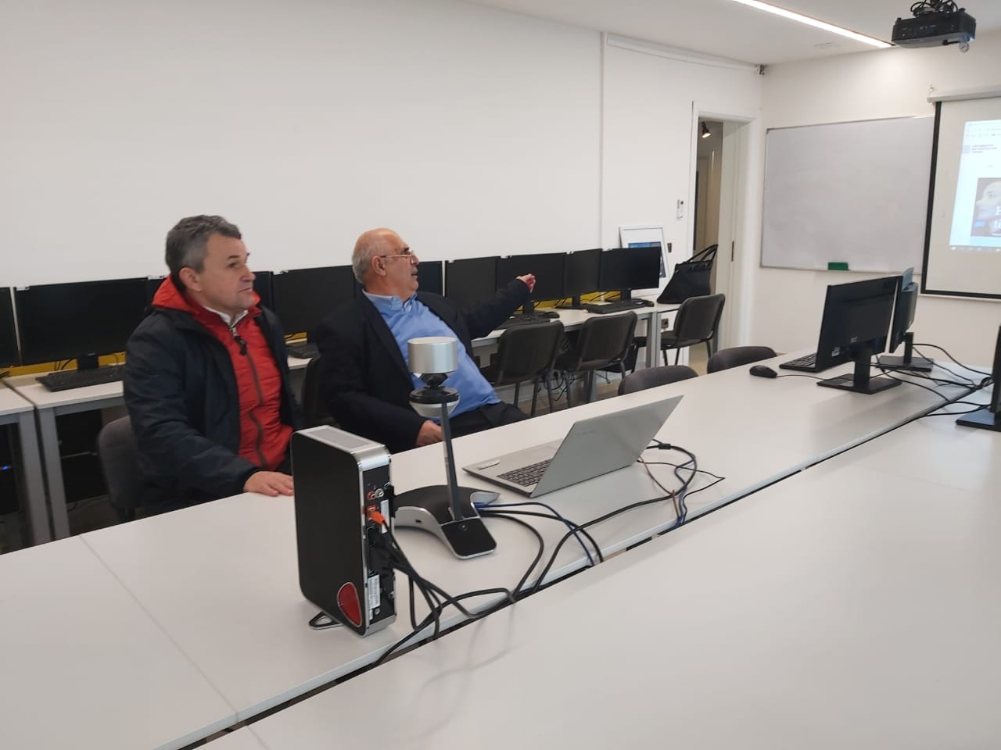
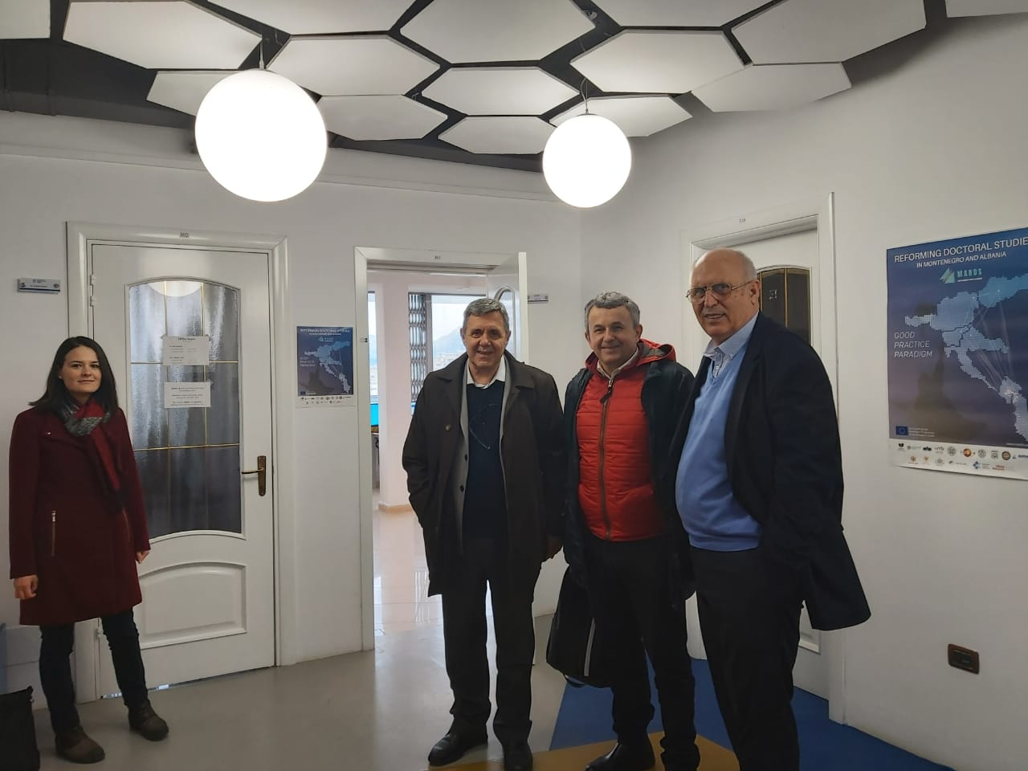
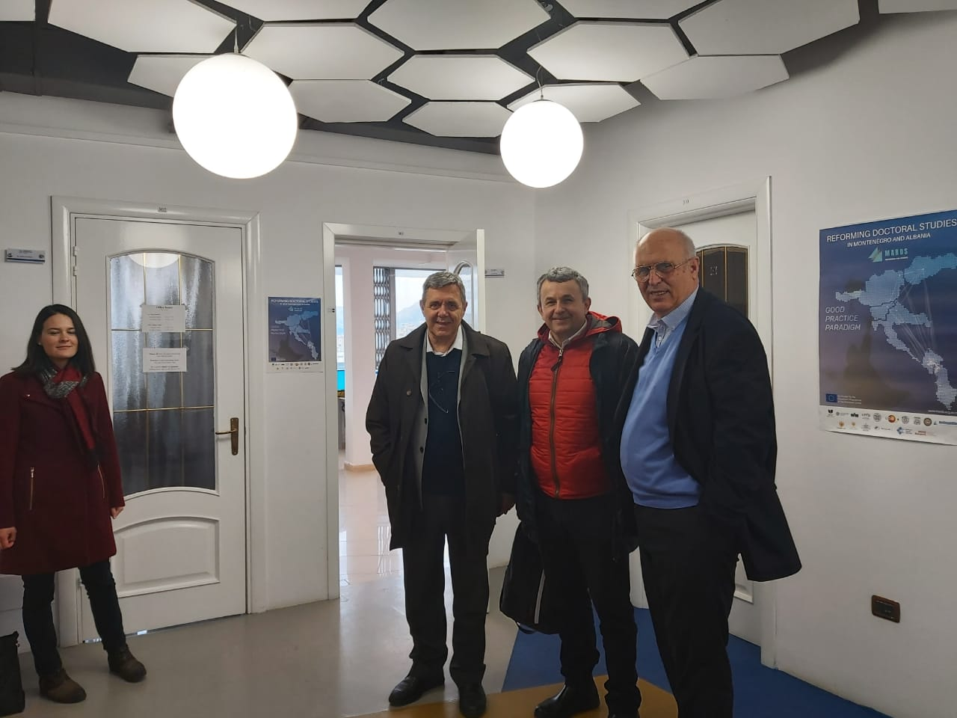
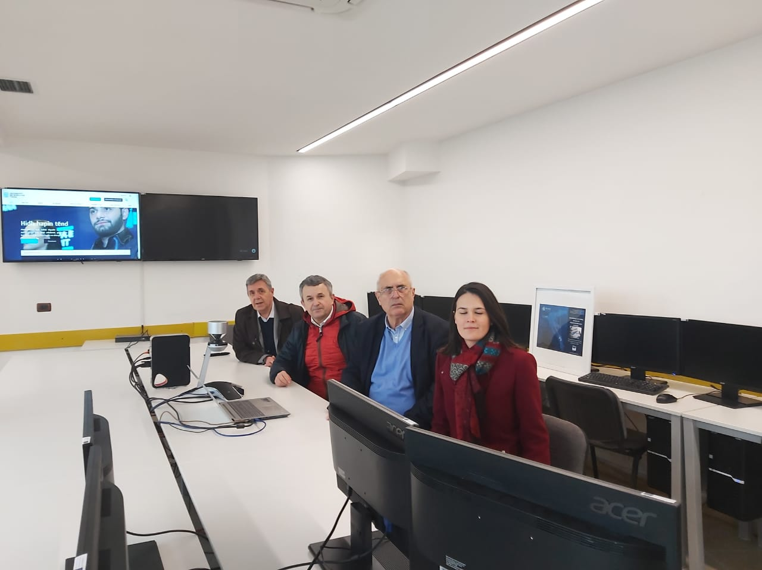
How to Design Smart Tourism
MARDS – Videoconference System

Slide 20
How to Design Smart Tourism
Conclusion?????
No Conclusion but Discussion
Welcome on the round smart table to work for the smart tourism and to improve the live of the new generation in our beautiful country!

