Slide 1

Smart Tourism
A personalized and selective approach on tourism services and products
Edmond Panariti PhD. Dr.hc

Slide 2
What is Smart ? and
What is Smart Tourism?
For something to be ‘smart’ it needs to have complex technological capabilities in order to allow for the exploitation of a range of information that is then used to inform product development and operation
‘Smart tourism is the act of tourism agents utilizing innovative technologies and practices to enhance resource management and sustainability, whilst increasing the businesses overall competitiveness’.

Slide 3
Smart Tourism needs Smart Destinations
A destination facilitating access to tourism and hospitality products, services, spaces and experiences through ICT-based tools. It is a healthy social and cultural environment, which can be found through a focus on the city´s social and human capital. It also implements innovative, intelligent solutions and fosters the development of entrepreneurial businesses and their interconnectedness.’
Source: European Capital of Smart Tourism

Slide 4
What kind of Environment need Smart Tourism Destinations?
Smart Tourism Destinations need:
(1) Technology embedded environments;
(2) Responsive processes at micro and macro levels
(3) End-user devices in multiple touch-points;
(4) Engaged stakeholders that use the platform dynamically as a neural system.’

Slide 5
Ways to Implement Smart Tourism
Smart tourism accessibility options
Smart tourism sustainability initiatives
Smart tourism information sharing
Smart tourism research and management tools
Smart tourist experiences

Slide 6
Smart tourist experiences
The most obvious type of smart tourism (for the tourist at least), is the smart tourist experience.
Destinations, attractions and other tourism providers are now adopting innovative technological approaches to develop and enhance the tourism experience that they offer. This ranges from augmented reality applications to gaming and virtual reality.
In the UK, The Hub Hotel from Premier Inn has made augmented reality compatible with the wall maps in the hotel rooms. When these maps are viewed through a smart device the wall maps present additional information about some of the local places of interest.

Slide 7
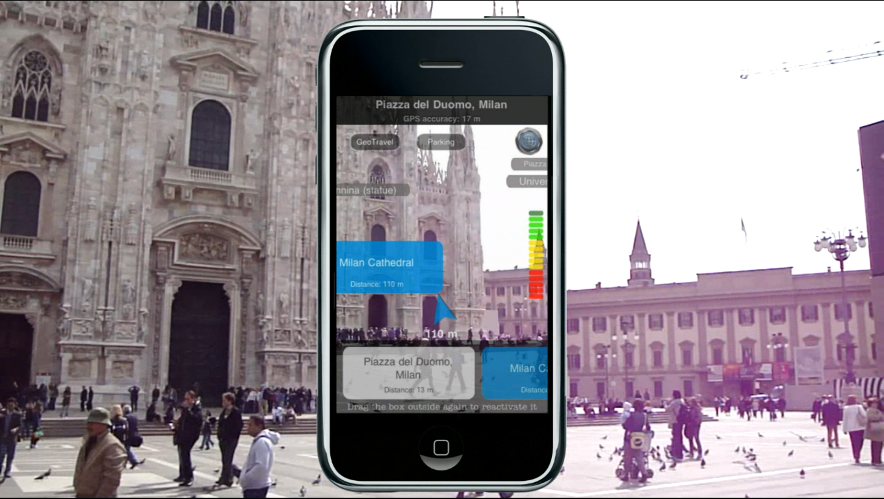
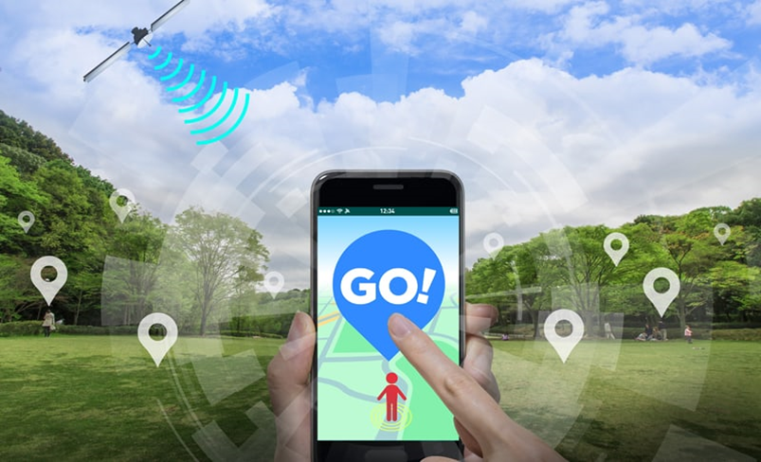
Augmented Reality!

Slide 8
Virtual Reality
My personal experiences:
In Dubai , flying on a carpet while visiting a tourist resort.
In Mount St Helen USA…a disaster touristic place. Virtually Experiencing what happened during the Volcanic Eruption some 40 years ago.

Slide 9
Smart tourism: Conclusion
Is smart tourism the future of tourism?
I would say so, yes.
There are some brilliant examples of smart tourism initiatives in Albania

